Slide 1

‎ ELDORADO‎ ‎ ‎ ‎ do Brasil!?‎ ‎ ‎
A BRIEF LOOK ON WHY A PARTNERSHIP WITH MAGIST IS RISKY, DUE TO DELIVERY TIME

Slide 2
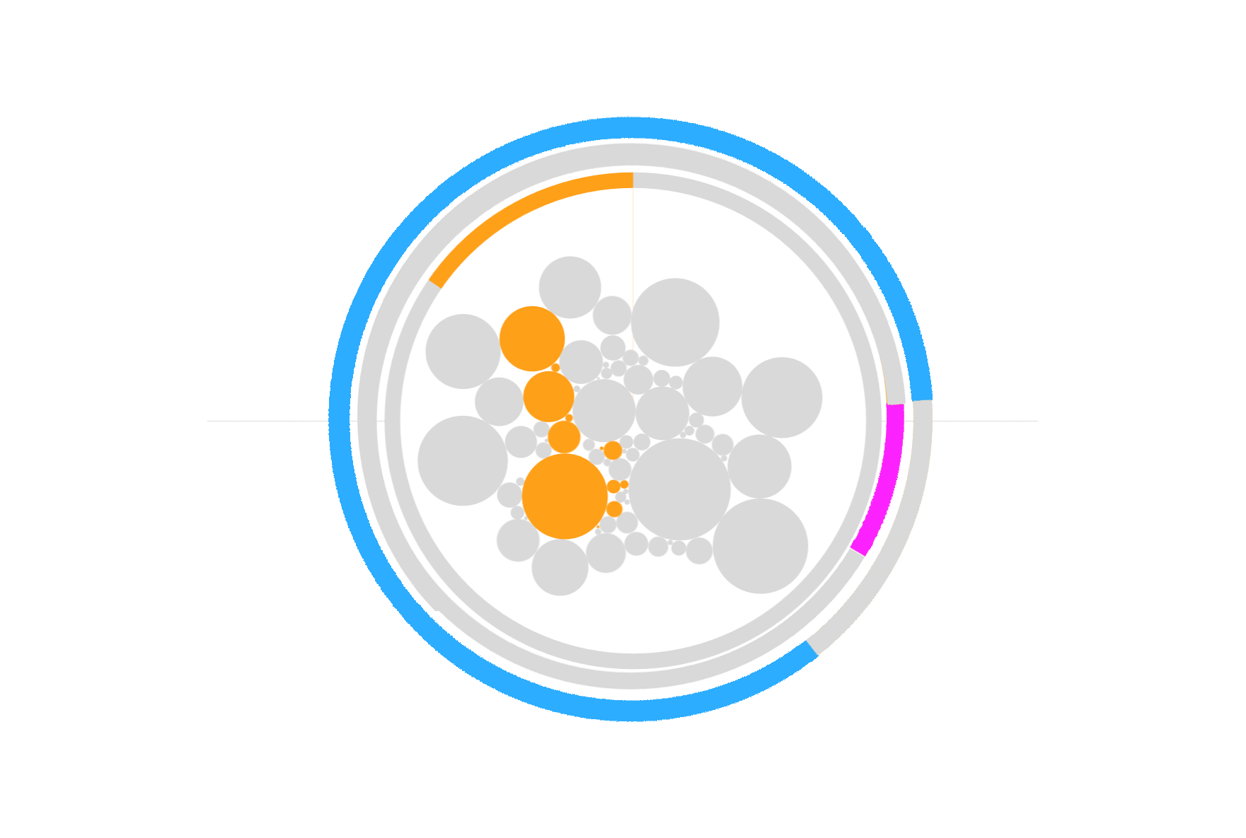
THE NUMBERS TELL!
only
18.8%
TECHPRODUCTS
only
5%
COST MORE THAN 300 EURO
only
9.5%
DELIVERY ON TIME

Slide 3
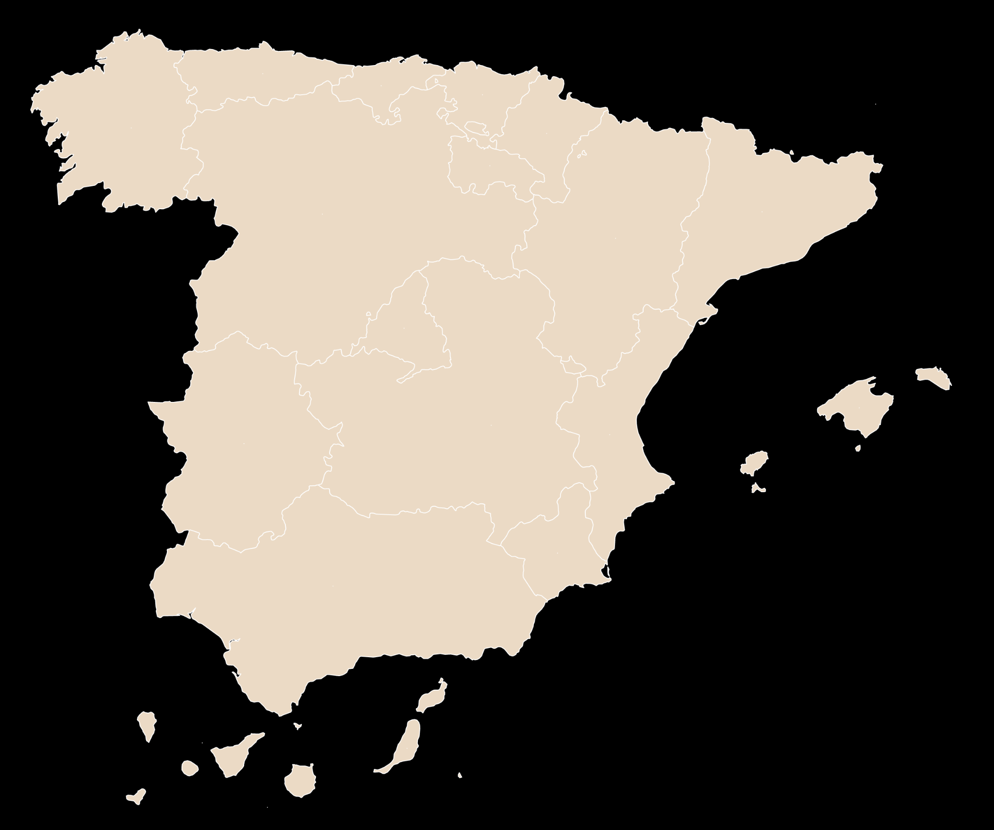
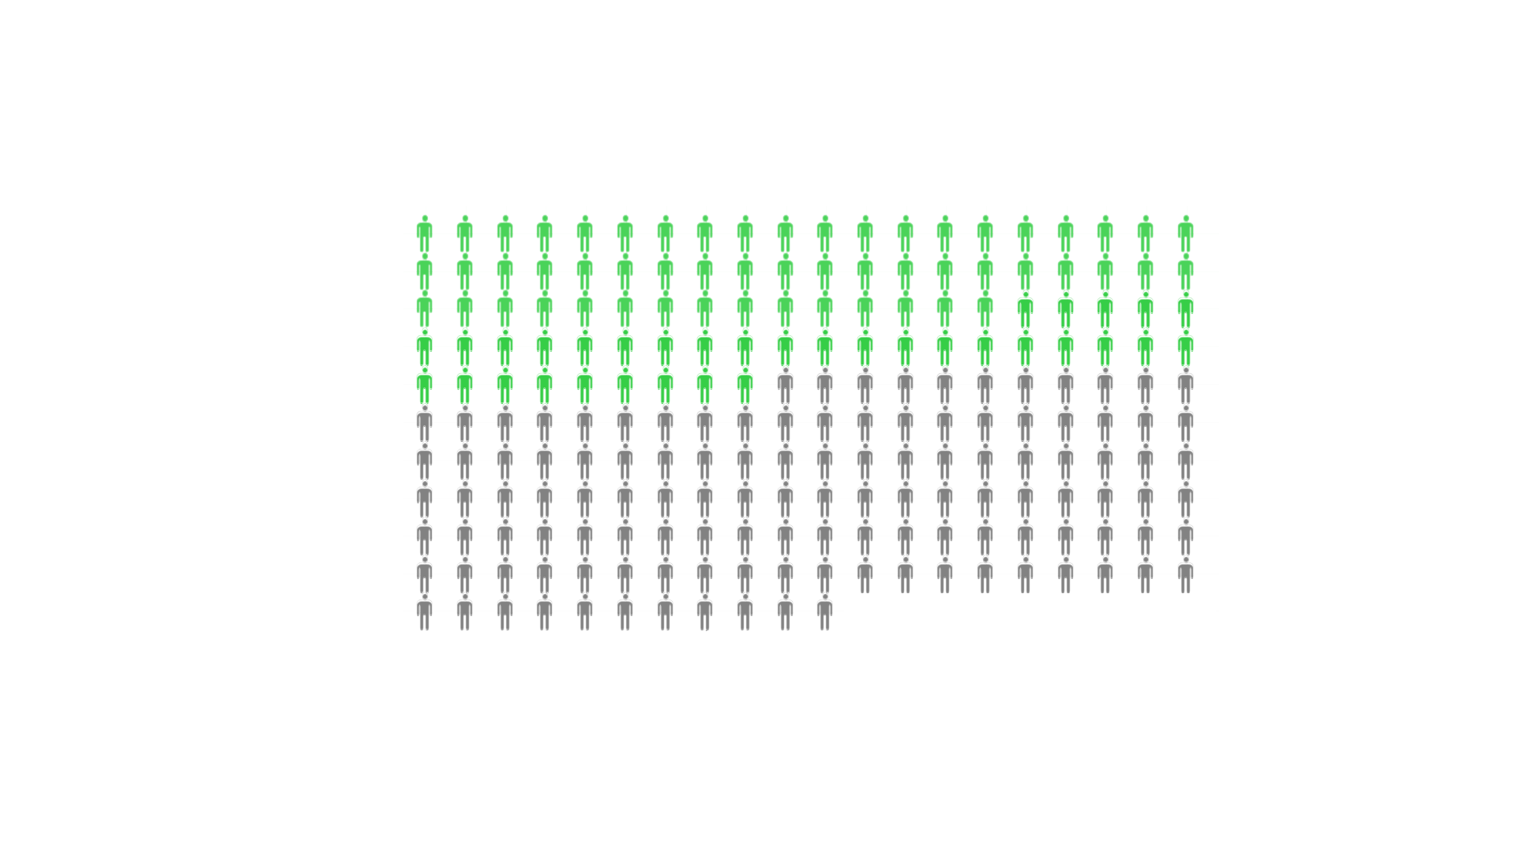
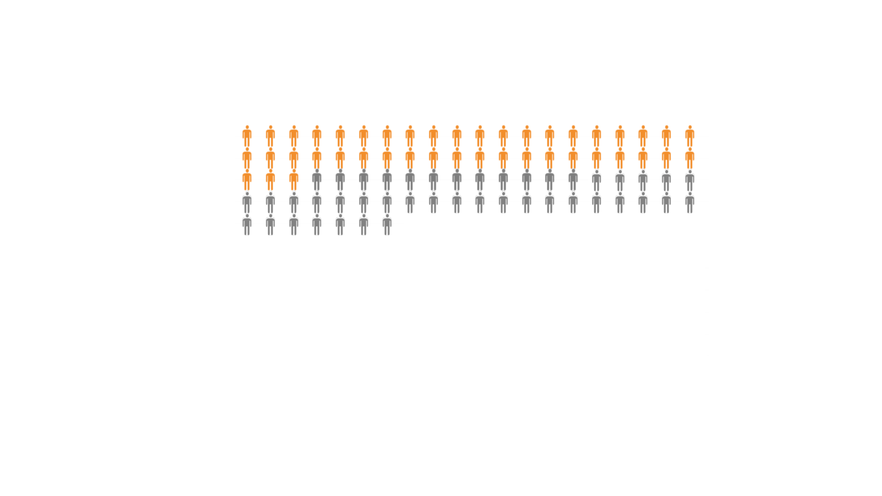
BRASIL
SPAIN
A MARKET FOR HIGHCLASS TECH-PROCUCTS
population
211 mio
average income
625 EUR/month
23%
49mio
customers
population
47mio
average income
2.520 EUR/month
48%
23mio
customers

Slide 4
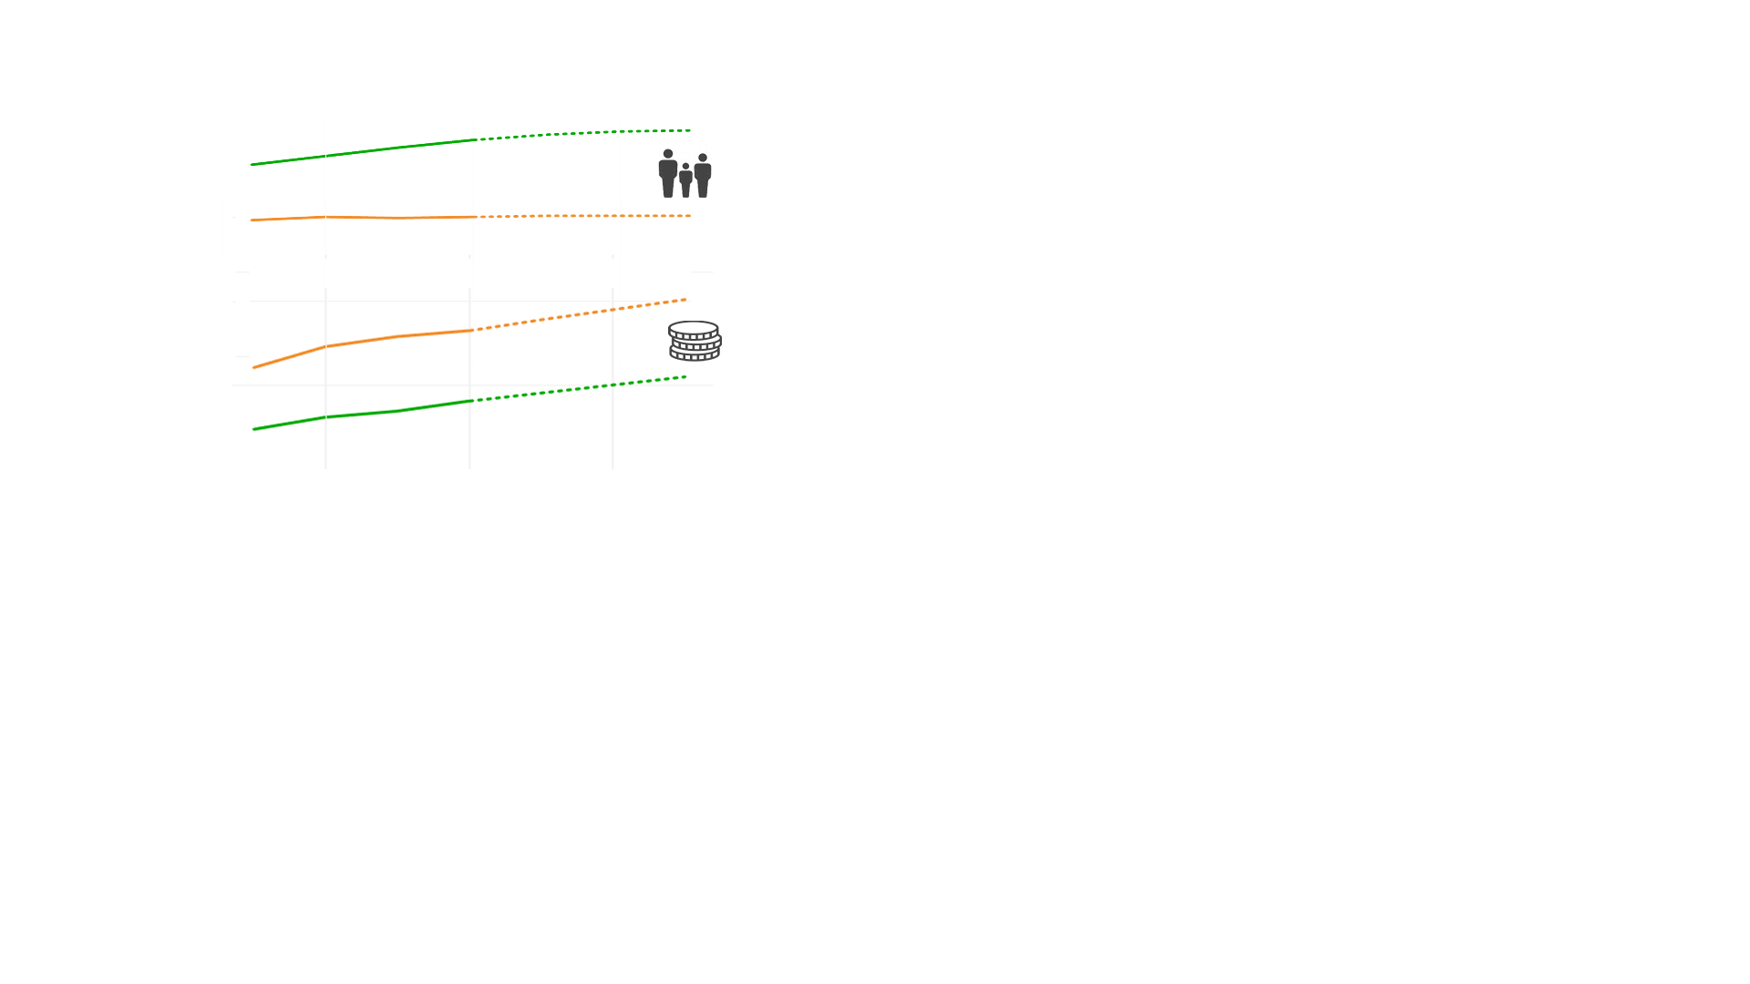

BRASIL IS A FUTURE MARKET COMPARED TO SPAIN
population income
+1.6% +46%
2035
2018
population income
+0.5% +19%
we are here

Slide 5
ARE ORDERS DELIVERED ON TIME?
1 week delayed: 20584
21.3%
Delivered
96478
Total Orders
99441
2 weeks delayed:
36927
38.3%
The numbers talk by themselves, the orders delivered on time are quite few, comparing the total
More than 2 weeks delayed:
32748
33.9%
On time: 9182
9.5%
Source: Magist DB
Notes:
*The percentage is based on the Delivered ones

Slide 6
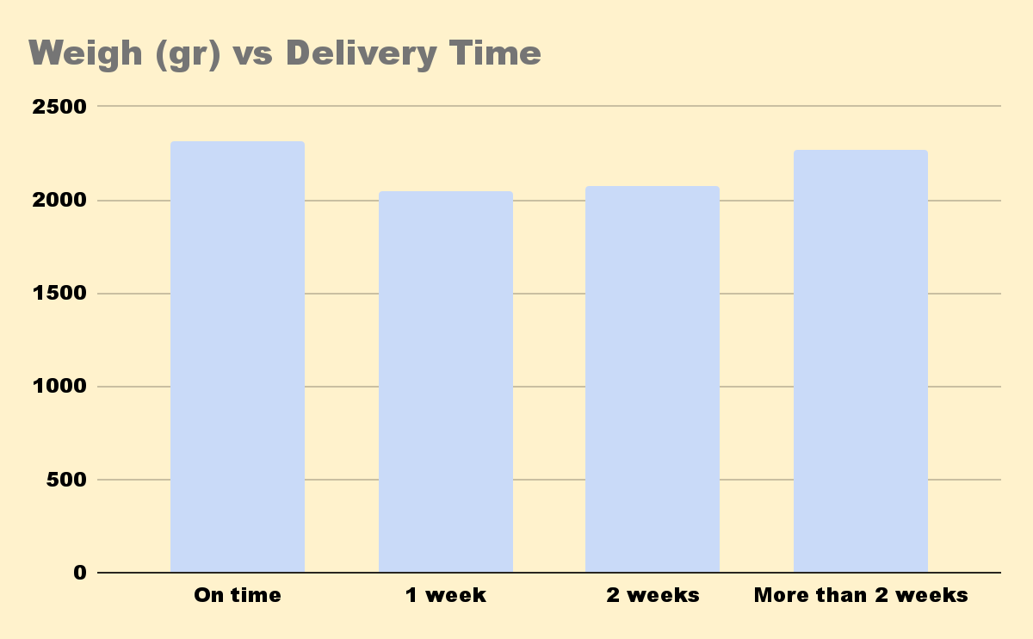

IS THERE ANY PATTERN FOR DELAYED ORDERS? For example, big products being delayed more often?
Average product weight for delayed orders
Source: Magist DB
Notes:
*The percentage is based on the Delivered

Slide 7
The average time between order and delivery?
12.5035 day

Slide 8
Decision and Suggestions
Reduce the internal order processing time
Add provisions for remote areas
Significantly improve the on-time delivery rate
Cooperate with local sellers
Self pick-up service

